Slide 1
Natural Products Chemistry
Amir E. Wahba, Ph.D.
Assistant Professor of Natural Products
Chemistry Department
Faculty of Science, Damietta University

Slide 2
Instructor
Dr. Amir E. Wahba
Research Interest:
Marine natural products, total synthesis of natural products, cancer chemotherapy, pseudo LDL nanoparticles for targeted delivery of cancer chemotherapy
Contact:
Office hours: Saturday, by appointment
Email: amirwahba@du.edu.eg

Slide 3
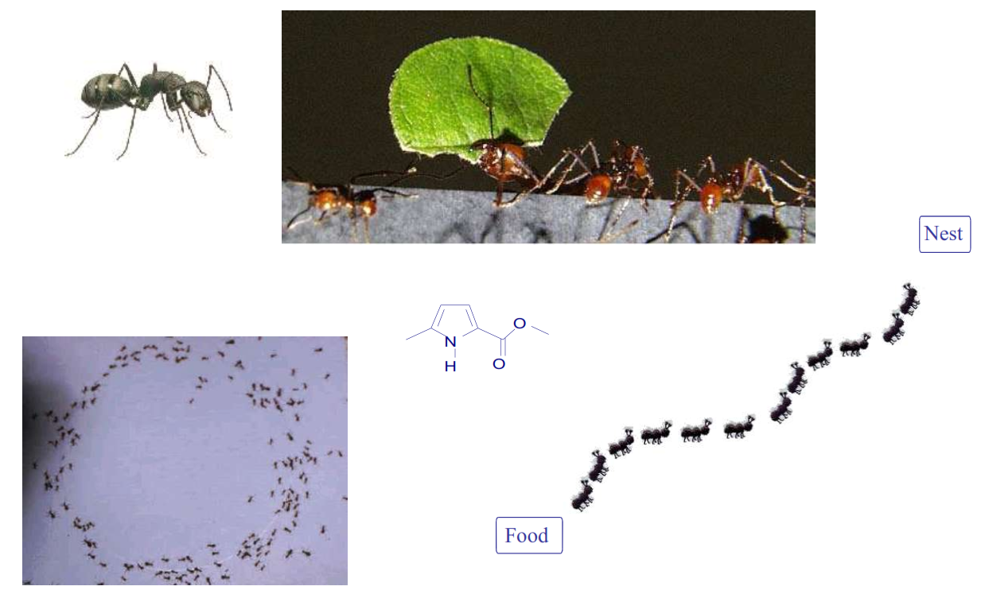
What Are Natural Products?

Slide 4
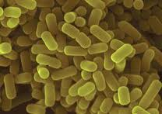
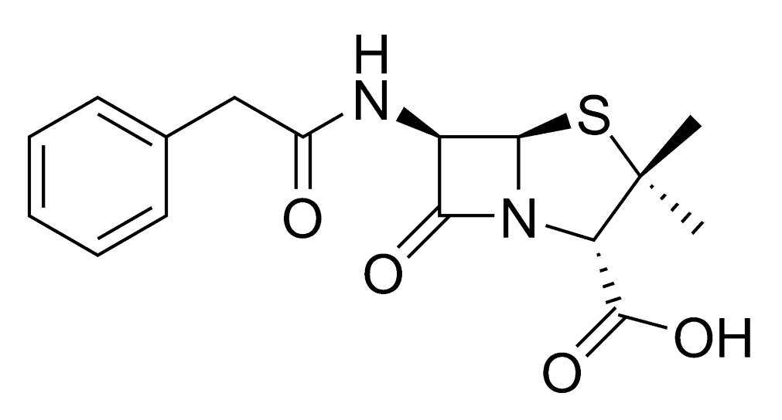
What Are Natural Products?

Slide 5
What are Natural Products?
Living organisms produces natural products for several reasons:
Live
Grow
Reproduce
Defense
Communicate
Examples of living organisms that produces natural products:
Bacteria
Fungi
Plants
Marine organisms (sponges, alga...etc)

Slide 6
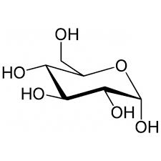
How Do plants produces chemicals? Biosynthesis

Slide 7
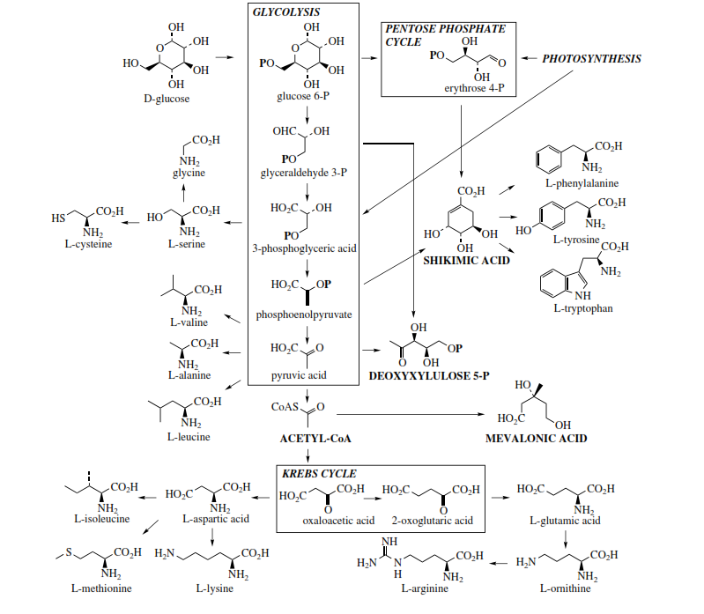

Slide 8
Primary Metabolism: All the chemical reactions necessary for the live of the organism by itself.
Primary Metabolites: All the chemical products involved in the Primary Metabolism.
Secondary Metabolites: All the chemical products that are produced by the living organism but are NOT involved in the primary metabolism. Not necessary for the live of the organism by itself but useful for interaction with others (chemical communication, chemical defenses).

Slide 9
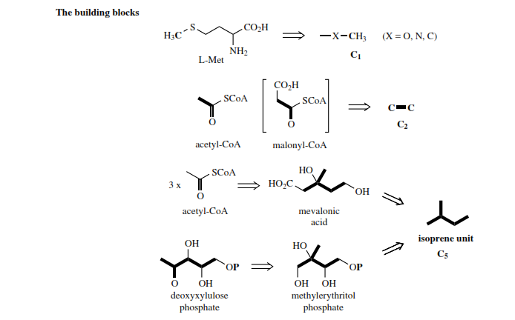
Biosynthesis: Building Blocks

Slide 10
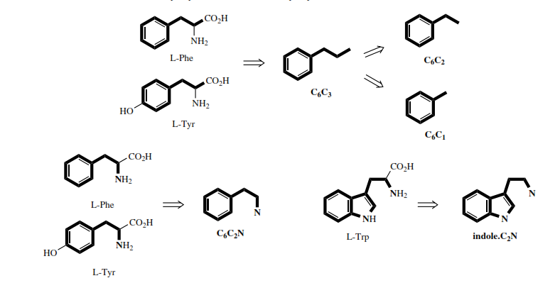

Slide 11
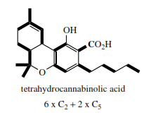
Tetrahydrocannabinol
Moderate analgesic

Slide 12
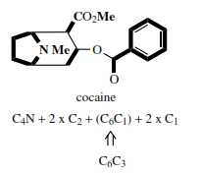

Slide 13
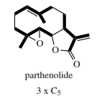

Slide 14
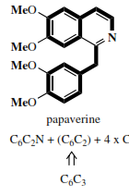

Slide 15
Terpenes
Volatile oily compounds
Usually give the smells of plants
Essential oils
All aliphatic compounds
Biosynthetically obtained from isoprene unit

Slide 16
Terpenes: Classification
Number of carbon atoms | Class
10 | Monoterpenoids (C₁₀H₁₆)
15 | Sesquiterpenoids (C₁₅H₂₄)
20 | Diterpenoids (C₂₀H₃₂)
25 | Sesterterpenoids (C₂₅H₄₀)
30 | Triterpenoids (C₃₀H₄₈)
40 | Tetraterpenoids (Carotenoids) (C₄₀H₆₄)
>40 | Polyterpenoids

Slide 17
Terpenes: Isoprene Rule
Isoprene rule:

Slide 18
Monoterpenoids and Sesquiterpenoids
Isolation:
Steam distillation
Extraction with volatile solvents
Structure Elucidation:
Pure sample
Molecular formula
Mass spectrophotometer
Chemical reactions
Complete Structure:
Chemical methods
Modern Spectroscopy (IR, NMR, 2D-NMR)

Slide 19
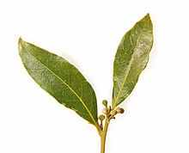
Myrcene
Acyclic monoterpenoid hydrocarbon
Isolated from verbena and bay oils (ورق الغار أو ورق موسى)
Used in perfume industry and as flavoring material in cooking
Molecular formula: C₁₀H₁₆

Slide 20
General Chemical Methods
Catalytic hydrogenation:
Ozonolysis

Slide 21
Structure Elucidation of Myrcene

Slide 22
Structure Elucidation of Myrcene

Slide 23
Citral
60-80% in lemon grass oil
Smell of lemons
Molecular formula: C₁₀H₁₆O

Slide 24
Citral: Structure Elucidation
laevulic acid

Slide 25
Citral: Structure Elucidation

Slide 26
Expected questions:
Building blocks for the biosynthesis of natural products
A chemical puzzle that describe the structure elucidation of a terpenoid

